Slide 1

Stock Prediction App using Machine Learning
An interactive application leveraging machine learning to predict and visualize stock market prices using real-time data from Yahoo Finance.

Slide 2

The Challenge of Stock Market Prediction
Market Volatility
Stock prices fluctuate unpredictably due to news, global events, policies, and investor sentiment.
Non-linearity
Price movements follow complex patterns that traditional statistical models struggle to capture.
Data Overload
Markets produce massive amounts of data every second, making it difficult to filter noise from meaningful patterns.
External Factors
Unexpected events like pandemics or political conflicts can drastically change market behavior.

Slide 3
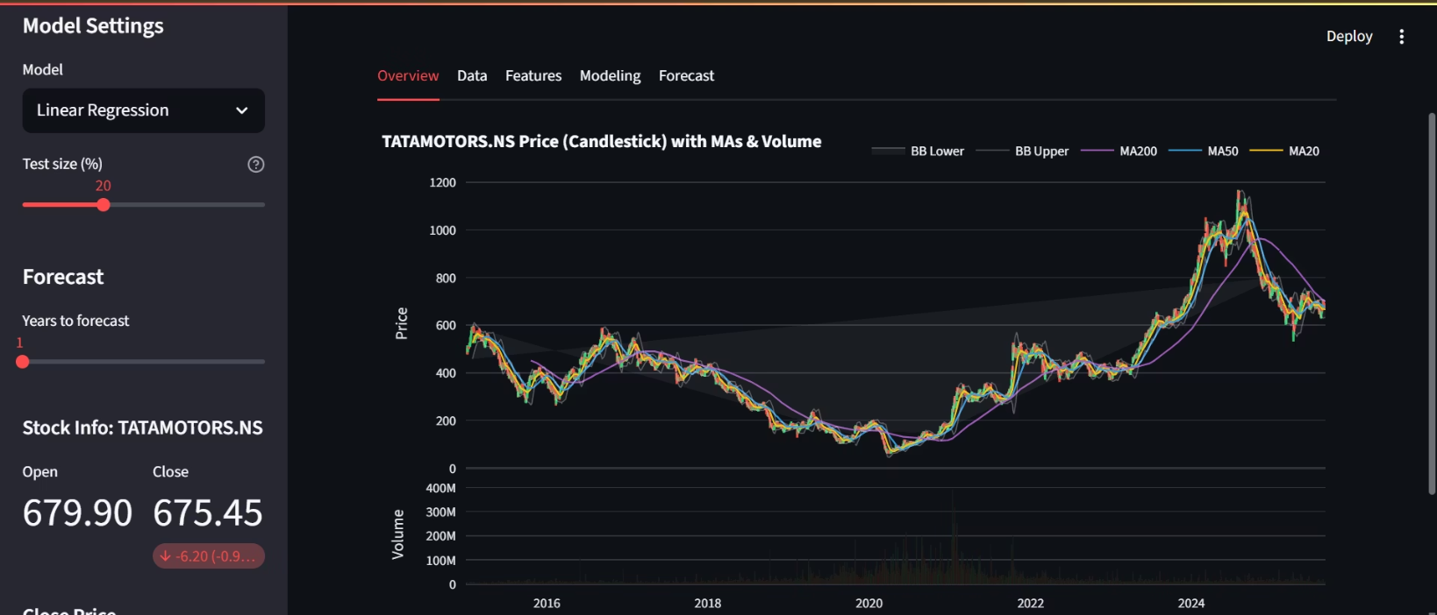
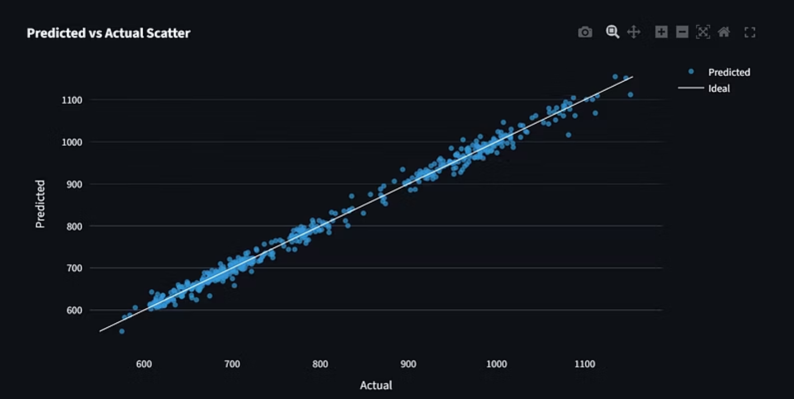
Why Machine Learning?
Traditional Methods Fall Short
ML Advantages
Fundamental and technical analysis rely on human interpretation and struggle with complex, non-linear patterns in massive datasets.
Identifies hidden patterns in historical data
Adapts quickly to new information
Uses multiple indicators simultaneously
Handles large datasets efficiently

Slide 4





System Architecture
Data Source
Yahoo Finance API fetches historical stock data including Open, High, Low, Close, and Volume.
Preprocessing
Feature engineering creates moving averages, Bollinger Bands, and lag features.
ML Training
Linear Regression, Decision Tree, and Random Forest models learn from patterns.
Evaluation
RMSE metrics and visualizations assess model accuracy.
Forecasting
Trained models predict future prices up to 4 years ahead.

Slide 5




Technical Stack
Python & Streamlit
yfinance
Core programming language with interactive web framework for building the dashboard interface.
Library for fetching real-time historical stock data from Yahoo Finance API.
scikit-learn
Plotly & Pandas
Machine learning library implementing Linear Regression, Decision Tree, and Random Forest models.
Visualization tools for candlestick charts and data manipulation for preprocessing.
Hardware Requirements: Intel i3+ processor, 4GB RAM minimum (8GB recommended), 1GB storage, internet connection required.

Slide 6
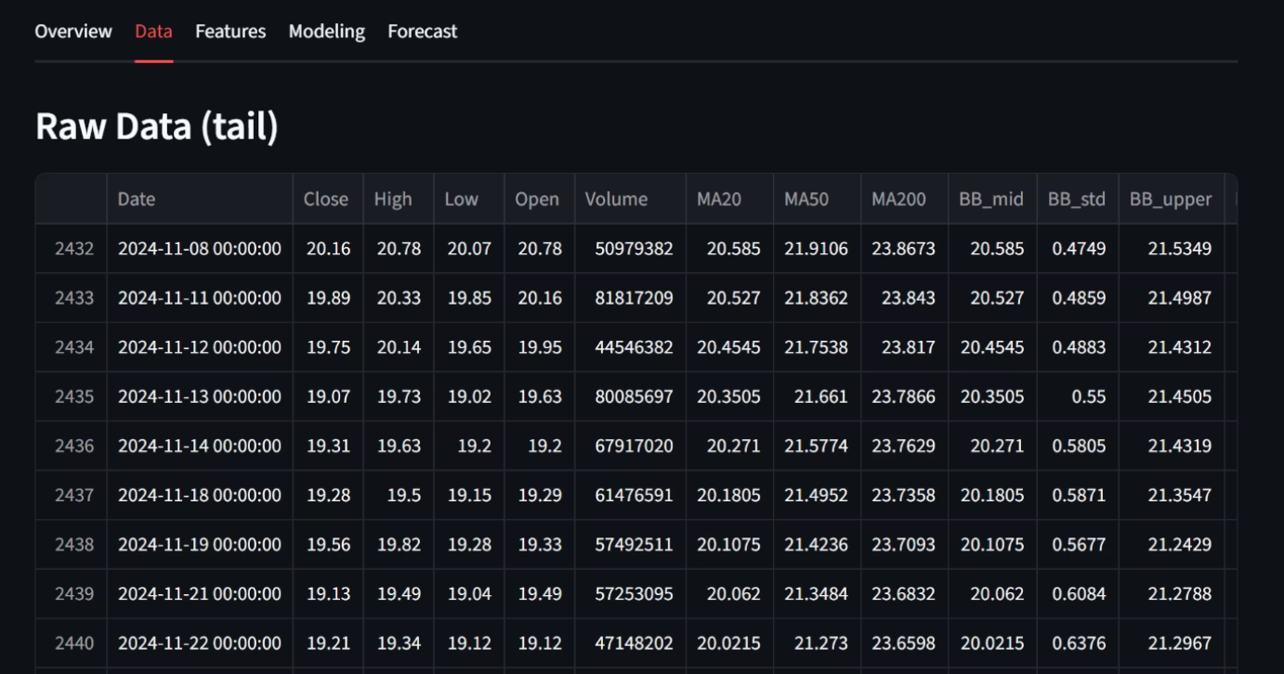
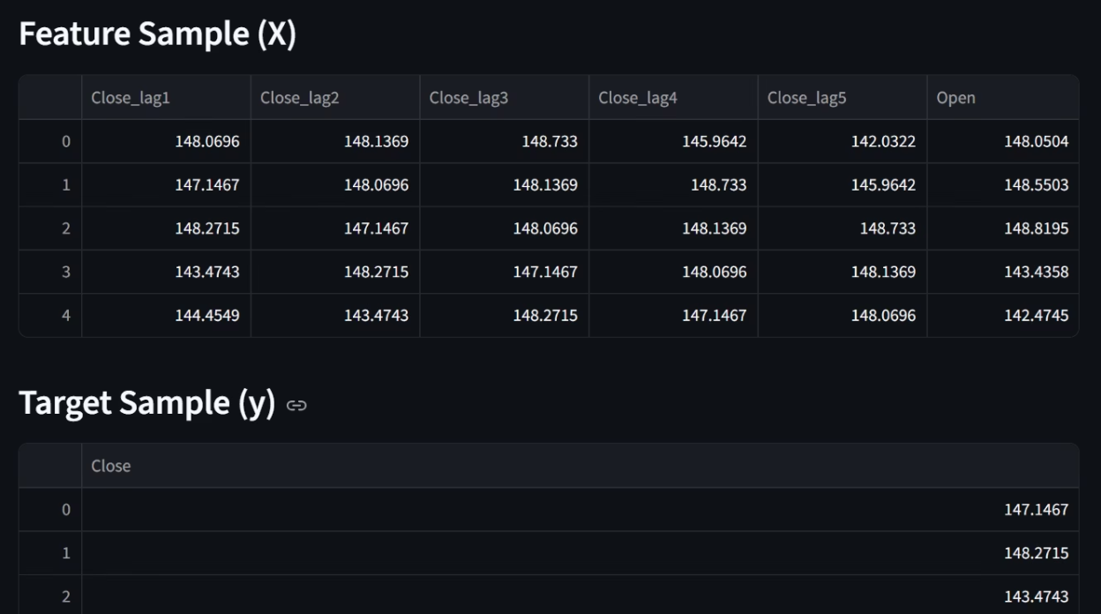
Data Collection & Feature Engineering
Raw Data Attributes
Engineered Features
Open, High, Low, Close prices
Lag Features: Previous day closing prices (Close_lag1, Close_lag2)
Adjusted Close (splits/dividends)
Moving Averages: MA20, MA50, MA200 for trend direction
Trading Volume
Bollinger Bands: Upper & Lower bands capturing volatility
User-selected ticker and date range

Slide 7



Three ML Models Compared
Linear Regression
Approach: Fits straight-line relationship between features and target price.
Strength: Fast, simple baseline model.
Weakness: Oversimplifies complex patterns.
Decision Tree
Approach: Splits data into decision nodes to capture non-linear trends.
Strength: Interpretable, handles non-linearity.
Weakness: Prone to overfitting without tuning.
Random Forest
Approach: Ensemble of multiple decision trees.
Strength: Highest accuracy, reduces overfitting.
Weakness: More computationally intensive.

Slide 8

Model Performance & Evaluation
80%
RMSE
1st
Training Split
Accuracy Metric
Random Forest Wins
Chronological split ensures realistic forecasting with earliest 80% for training.
Root Mean Squared Error measures prediction accuracy across all models.
Consistently achieved lowest RMSE, balancing accuracy and generalization.
Evaluation Visualizations: Actual vs Predicted plots show model alignment with real prices. Residual plots display errors over time. Scatter plots compare predictions against ideal line. Feature importance charts reveal which indicators (lag features, moving averages) contributed most to predictions.

Slide 9
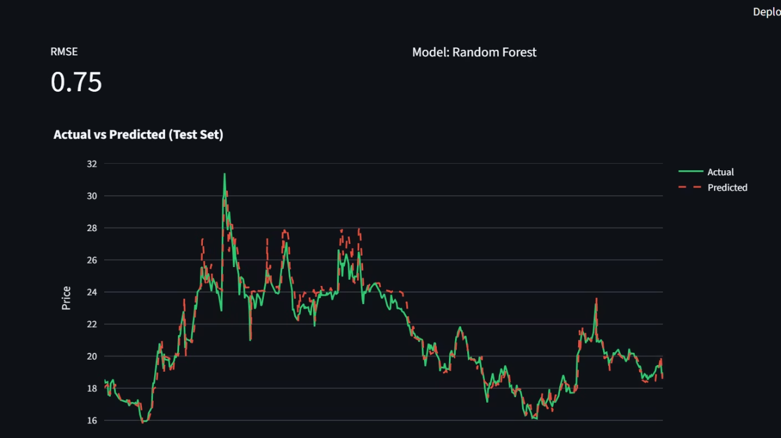

Forecasting Future Prices
Recursive Prediction Approach
Model predicts next day's stock price
Prediction becomes input feature for following day
Process continues for 1-4 year forecast horizon
Forecast charts display recent historical prices (green) alongside predicted future prices (red dashed line), allowing visual trend inspection.
Important Note: Short-term predictions are reasonably accurate, but long-term forecasts show increasing uncertainty. Results should be interpreted as trend indications, not financial advice.

Slide 10



Future Enhancements
Portfolio Analysis
Sentiment Analysis
Expand to portfolio-level analysis with risk assessment and diversification recommendations.
Deep Learning Integration
Analyze news articles and social media to gauge market sentiment and incorporate into predictions.
Incorporate LSTM networks to capture long-term temporal dependencies in stock price sequences.
Conclusion: The Stock Prediction App successfully integrates data collection, machine learning, and visualization into a user-friendly educational platform. While predictions offer valuable insights into market trends, they should complement—not replace—comprehensive financial analysis.

